Slide 1


Stock Price Prediction:
Models & Technical Analysis
October 31, 2024

Slide 2
Stock Price Prediction and Technical Analysis
Statistical Models for Stock Prediction
Technical Analysis for Understanding Trends (SMA EMA RSI OBV)
Trade Pattern Identification
Integration of Insights

Slide 3
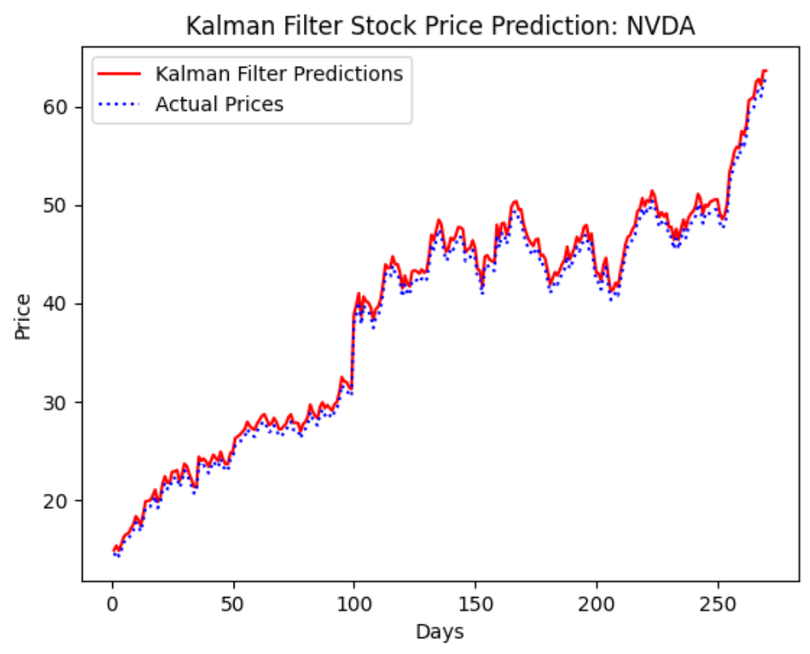
Kalman Filter
RMSE: $0.8757
# Initial Guess:
param0 = np.array([1.05, 0.96, np.var(Y)/200, np.var(Y)/100])
Key parameters:
Observation matrix = 1.05;
State transition matrix = 0.96;
Observation noise covariance = np.var(Y)/200;
State noise covariance = np.var(Y)/100;
Notes:
Xiaobin

Slide 4
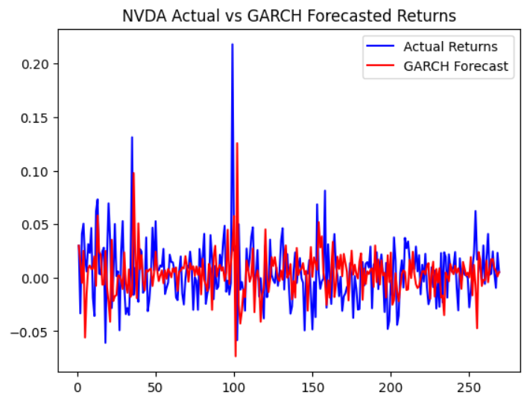
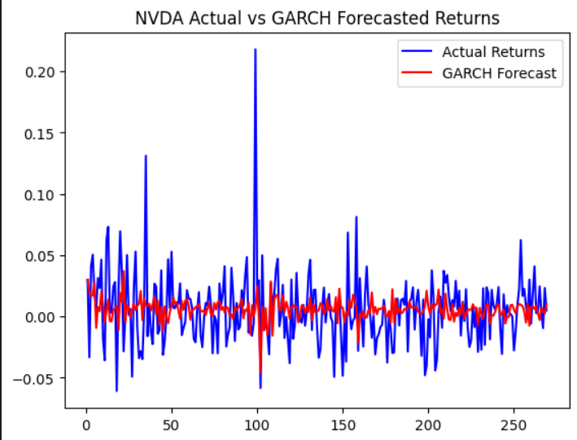
Garch - t Model
RMSE : 3.61%
param0 = np.array([np.mean(Y), np.var(Y) / 10500, 0.18, 0.5, 15])
Variance
ARCH
GARCH
Freedom
RMSE : 2.86%
param0 = np.array([np.mean(Y), np.var(Y) / 10000, 0.01, 0.8, 8])
V level
fluctuation
extreme value
Past Data
Notes:
Shihong

Slide 5
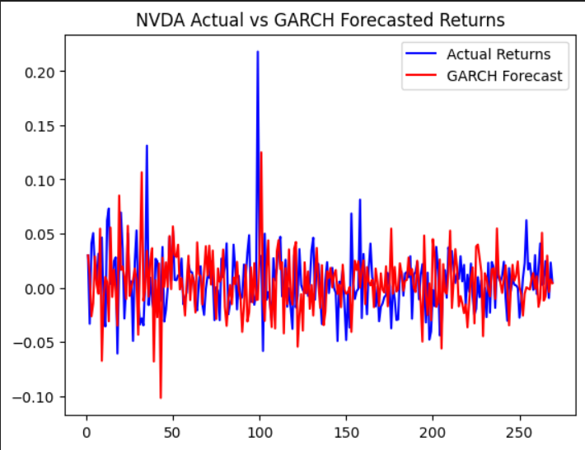
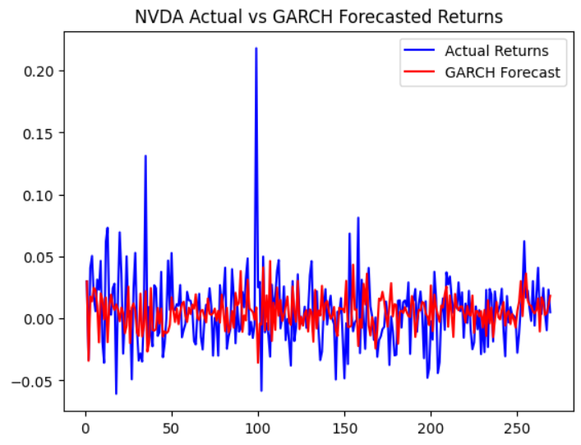
Garch - Mixture Model
param0 = np.array([np.mean(Y),np.var(Y)/3000, 0.3, 0.65, 0.01, 0.85, 0.01, 1.2, 0.6])
param0 = np.array([np.mean(Y), np.var(Y) / 1250, 0.25, 0.72, 0.005, 1.02, 0.015, 1.05, 0.53])
Past Data
fluctuation
Short Term Accuracy
Smoothing the Model
Large Swing
Reduce Weight
ARCH
GARCH
Mean1
V1
Mean2
V2
P Value
Variance
RMSE : 3.07%
RMSE : 3.80%
Notes:
Shihong

Slide 6

Stock Trend Identification:
- Mean Reversion Strategy
- Oscillators
Notes:
Zimo

Slide 7
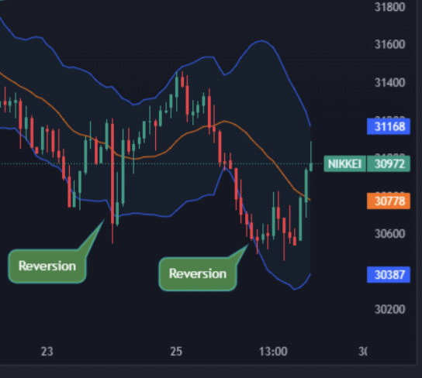
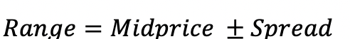
Stock Trend Identification
Mean Reversion Strategy
Definition:
Upper Bound :Mid price + Spread
SMA
EMA
Moving
Standard
Deviation
Lower Bound :Mid price - Spread
Notes:
Zimo

Slide 8
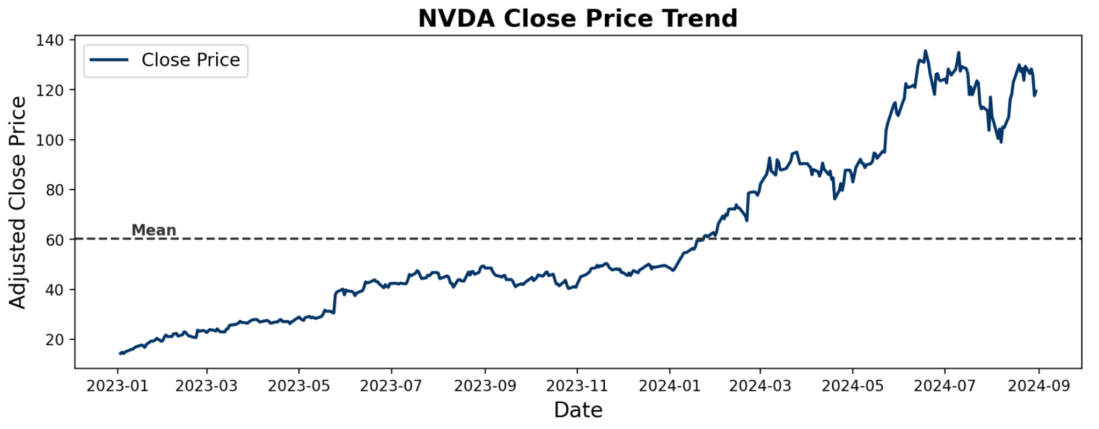
Mean Reversion Strategy
Limitations

Slide 9
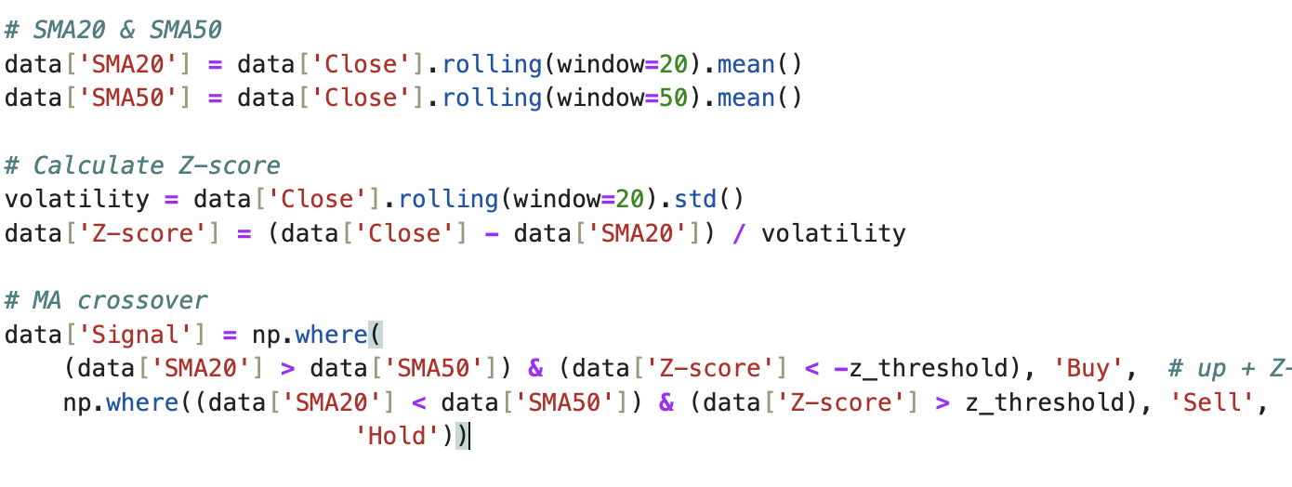
SMA20 & SMA50:
identify rising or falling trends
Mean Reversion Strategy
Improvement: MA Crossover Strategy
1
2
Z-score condition:
callback stage
When SMA20 > SMA50,
if Z-score lower than
-z_threshold),
generate a buy signal
when SMA20 < SMA50,
if Z-score higher than
z_threshold),
generate a sell signal

Slide 10
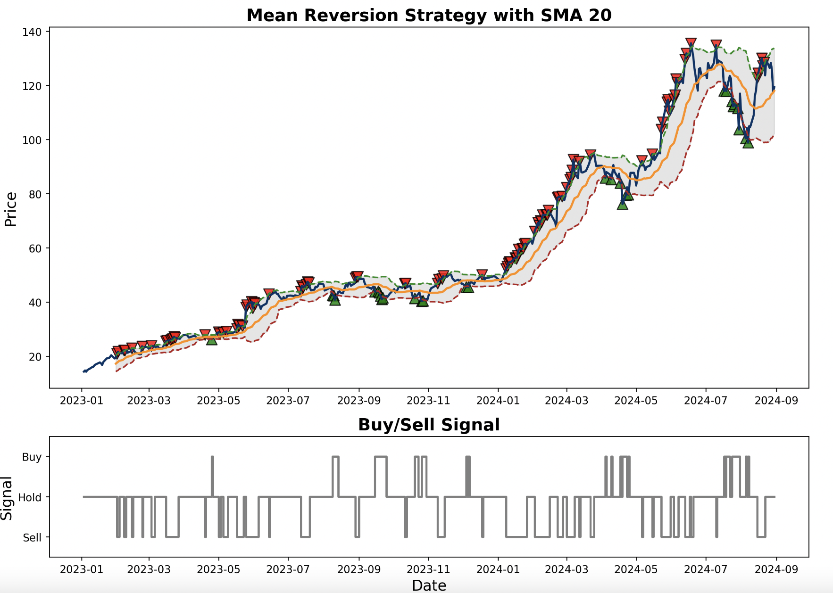
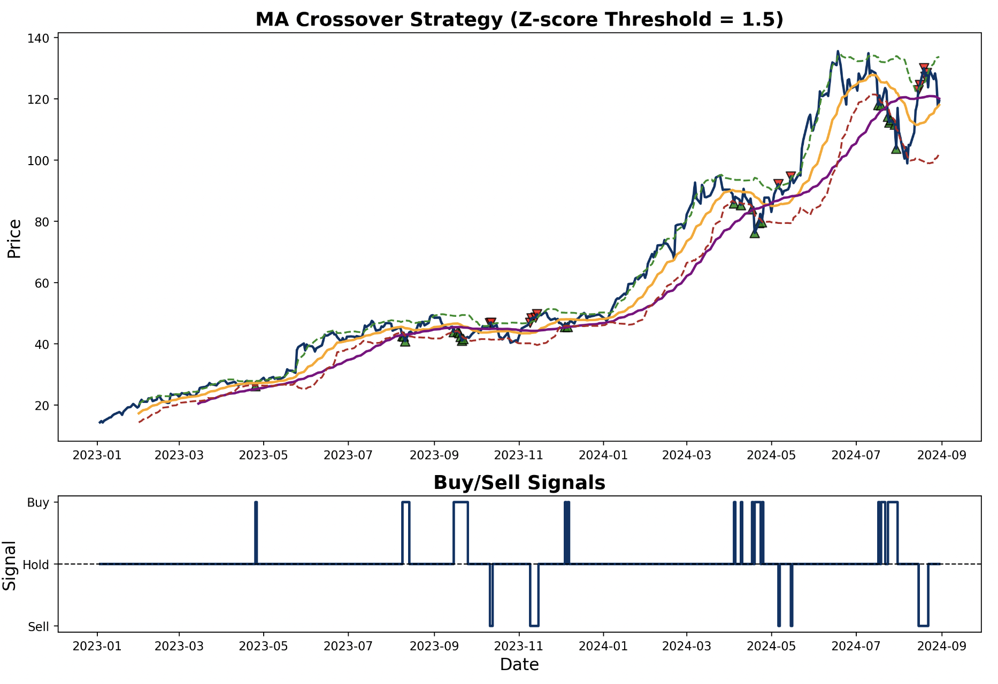
Improvement: MA Crossover Strategy
SMA 20 Visualization
MA Crossover Visualization
Notes:
Zimo

Slide 11
Stock Trend Identification:
- Oscillators Indicator:
Relative Strength Index
On-Balance Volume
Notes:
Zimo

Slide 12
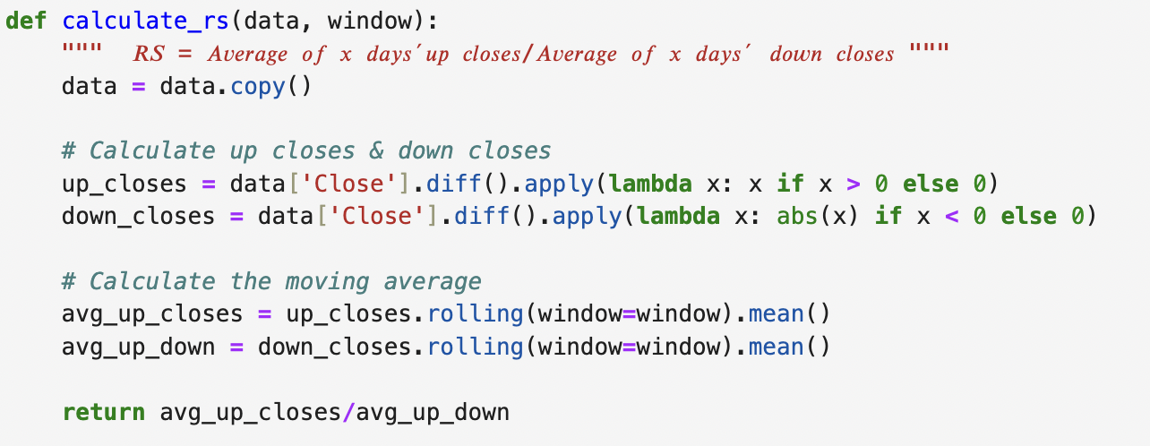
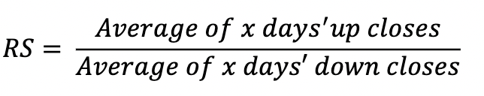
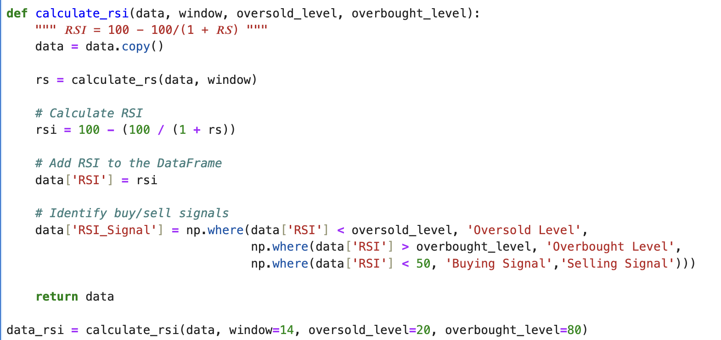

Relative Strength Index
Code:
Definition:
1
2
Notes:
Zimo

Slide 13
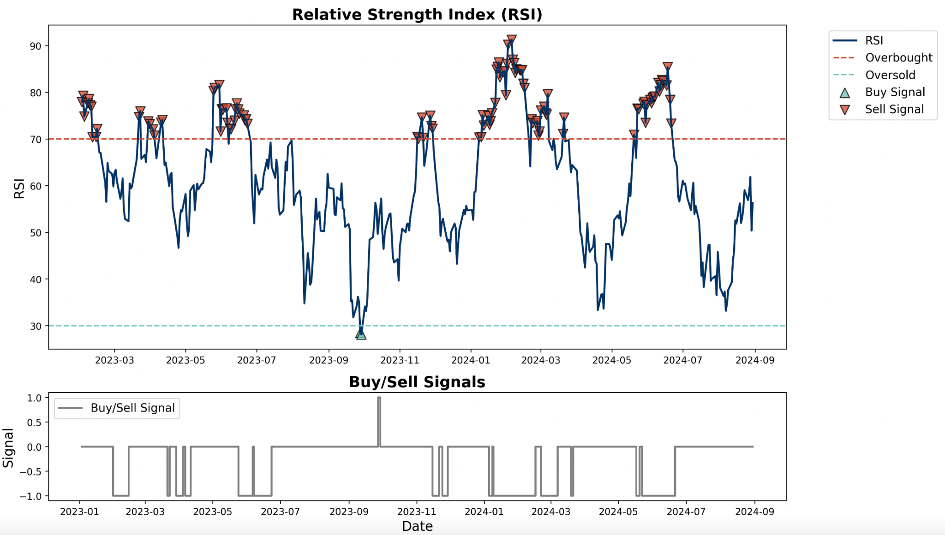
RSI Visualization
Notes:
Zimo

Slide 14
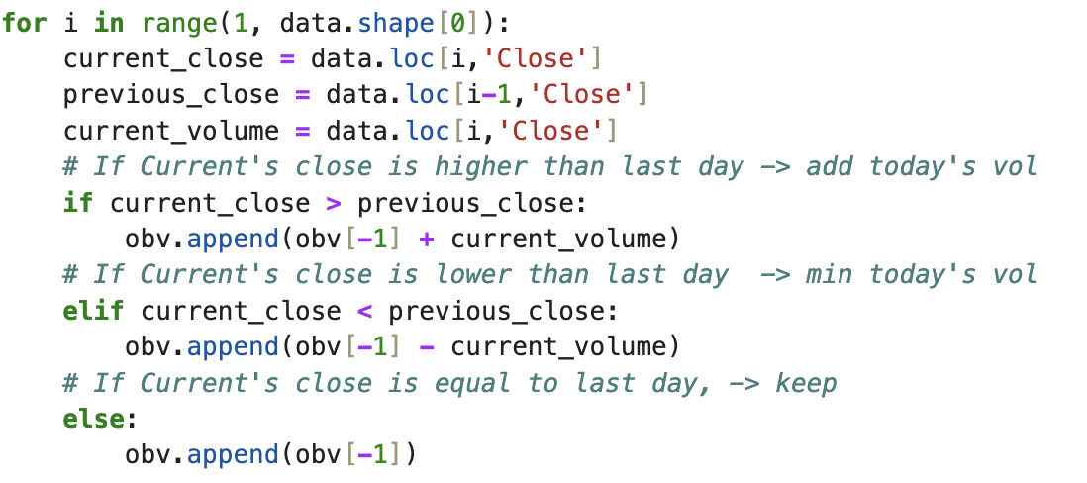
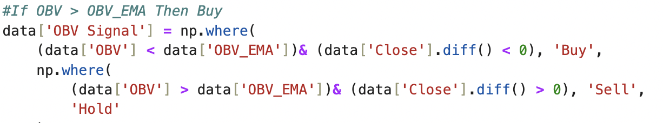
On-Balance Volume
Definition:
Implementation:
Set obv = 0
if today’s close price > last trading day:
obv+= today’s volume
elif today’s close price <last trading day:
obv -= today’s volume
else today’s close price = last trading day:
obv = today’s volume
Notes:
Zimo

Slide 15
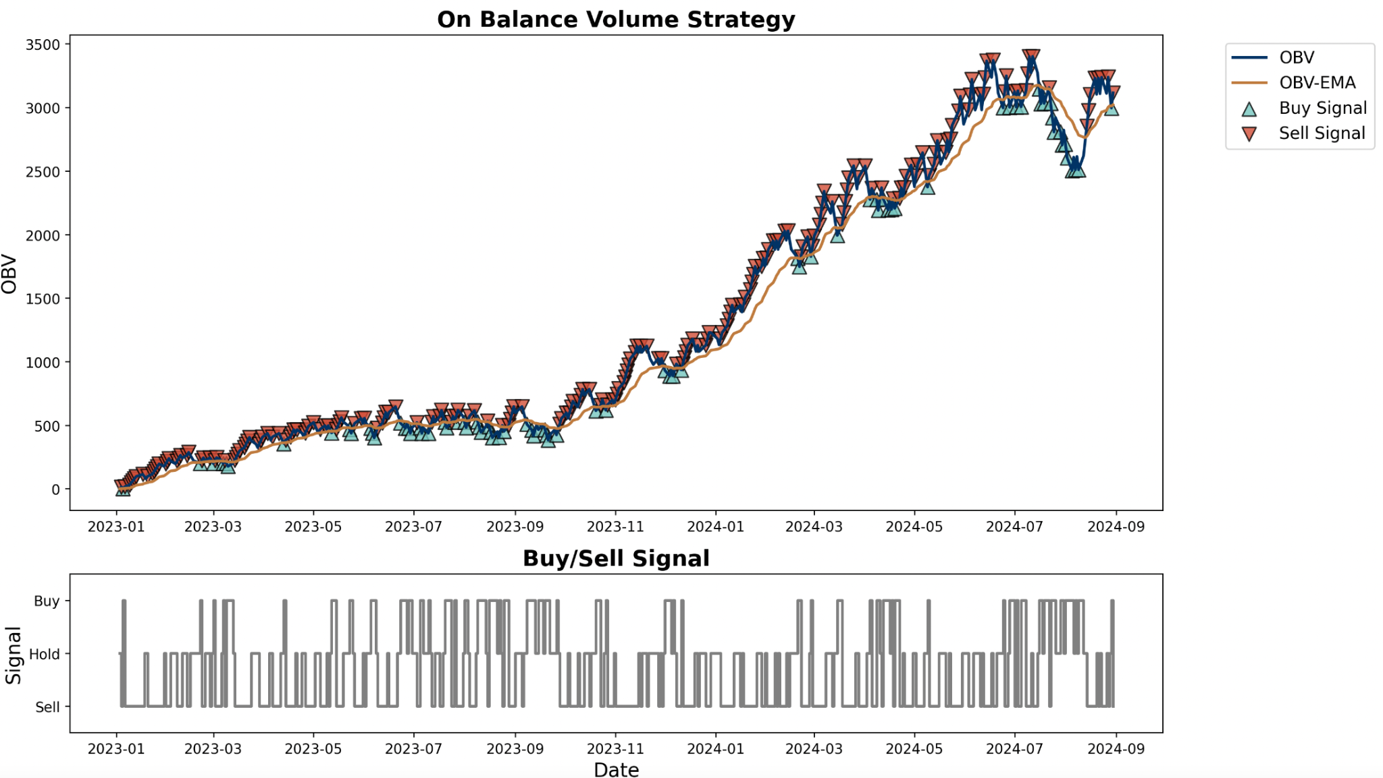
OBV Visualization
Notes:
Zimo

Slide 16
On-Balance Volume
Relative Strength Index
Stock Trend Identification
Future Improvements for
Parameter Optimization
Grid Search
Gradient Descent
Notes:
Zimo

Slide 17
Trade Pattern Identification
Notes:
Mengge

Slide 18
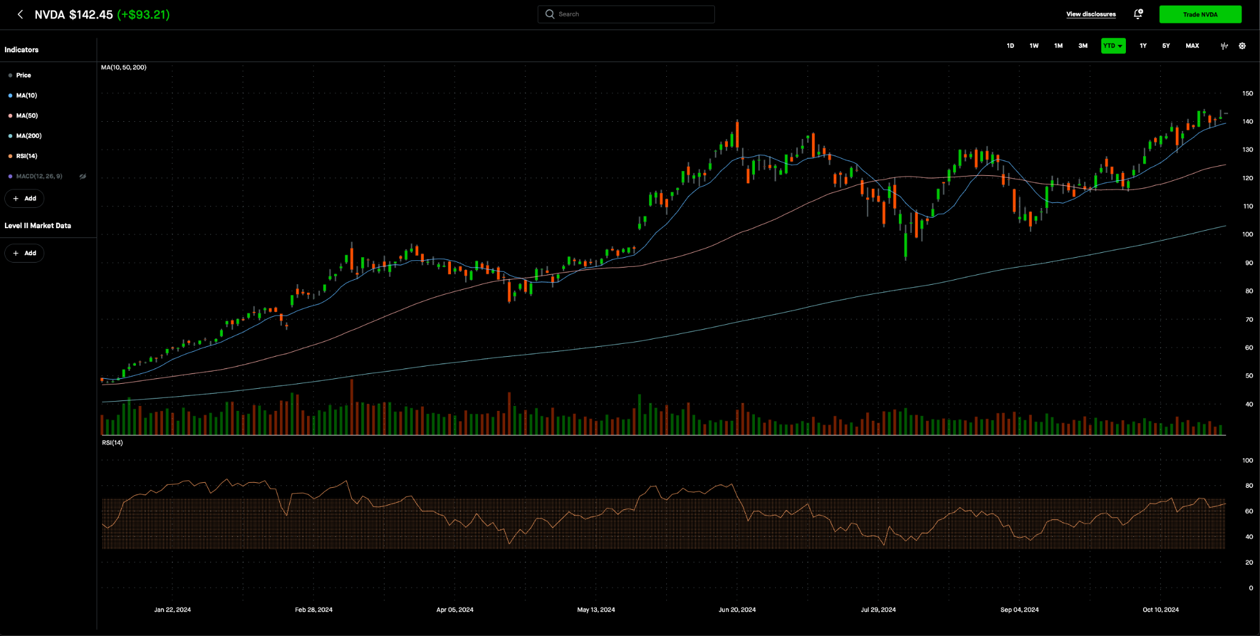
Candlestick Pattern Analysis
Outlook for 2024
Notes:
Mengge

Slide 19
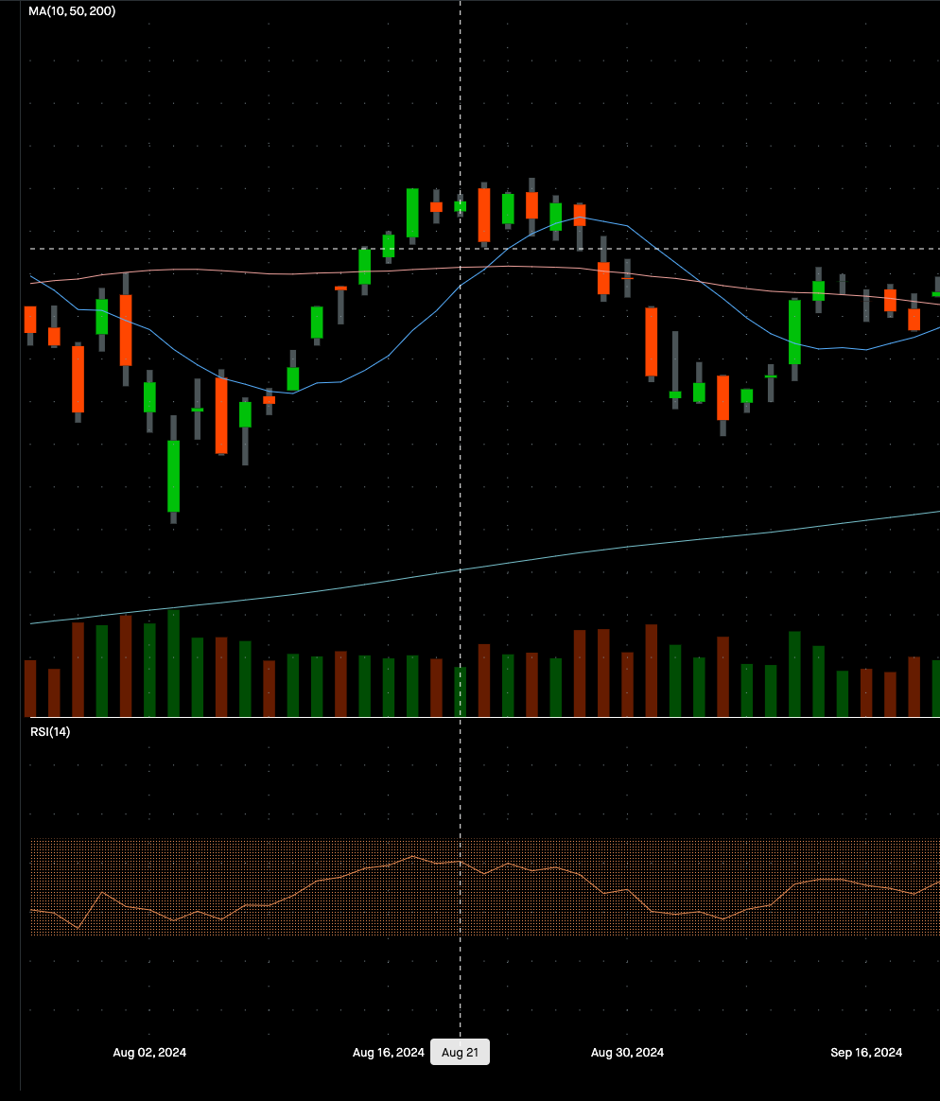
Candlestick Pattern Analysis
Doji
The doji indicates indecision in the market
Usually appears after strong trends
Notes:
Mengge

Slide 20
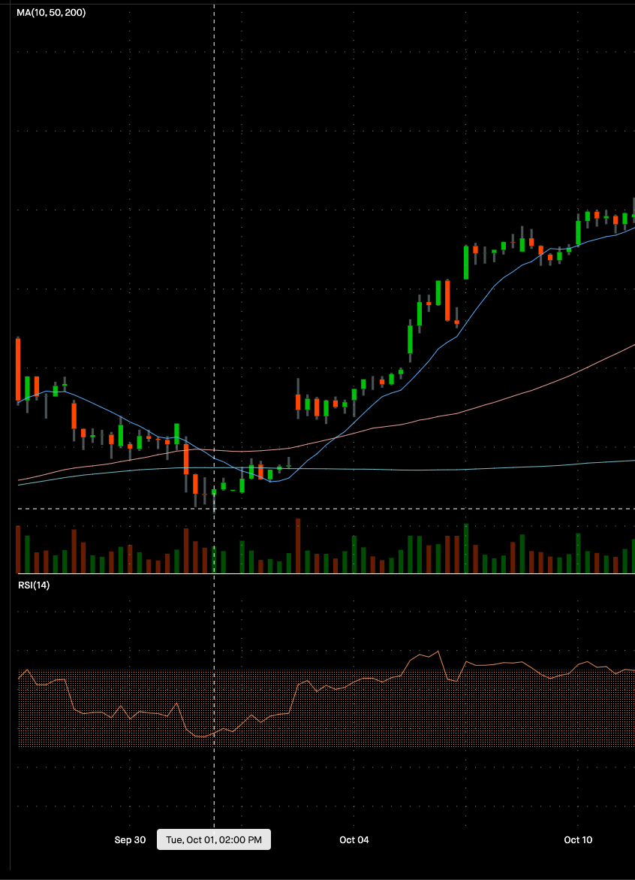
Candlestick Pattern Analysis
Hammer
Hammer has a small body and a long lower shadow, which indicates a potential bullish reversal after a downtrend
Notes:
Mengge

Slide 21
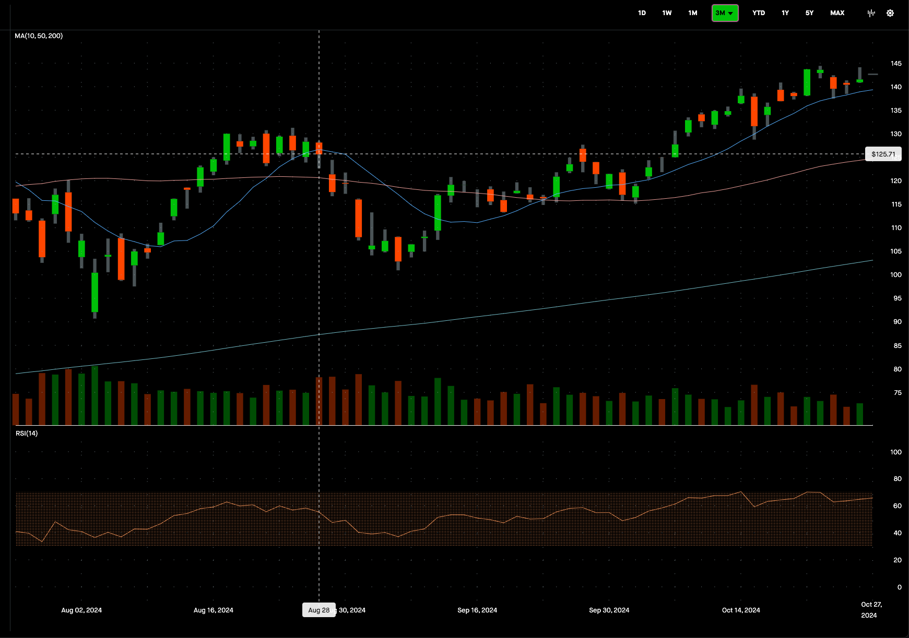
Candlestick Pattern Analysis
Hanging Man
The hanging man appears in uptrends and resembles the hammer but may suggest a bearish reversal
Notes:
Mengge

Slide 22
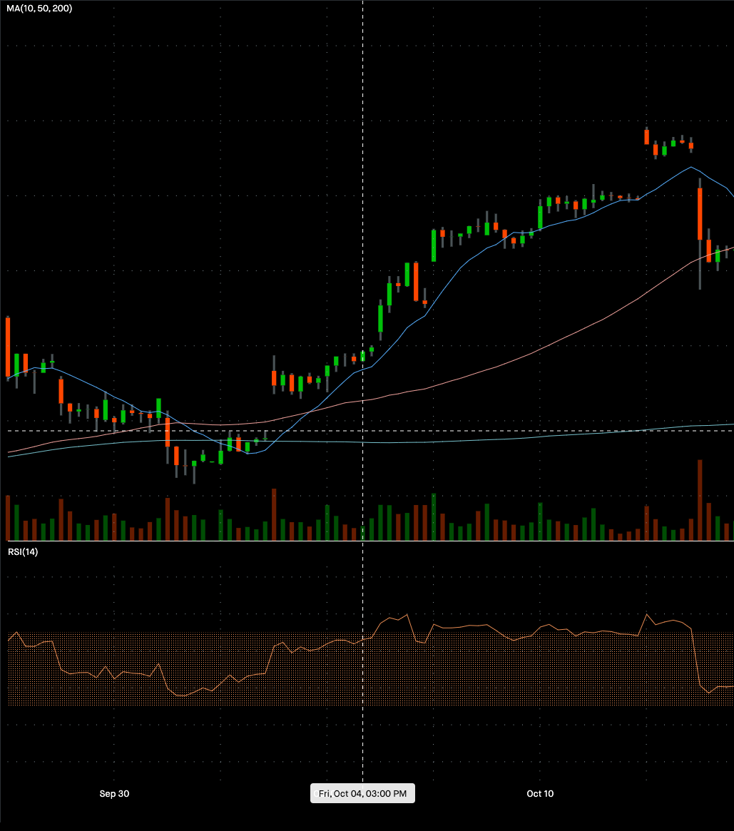
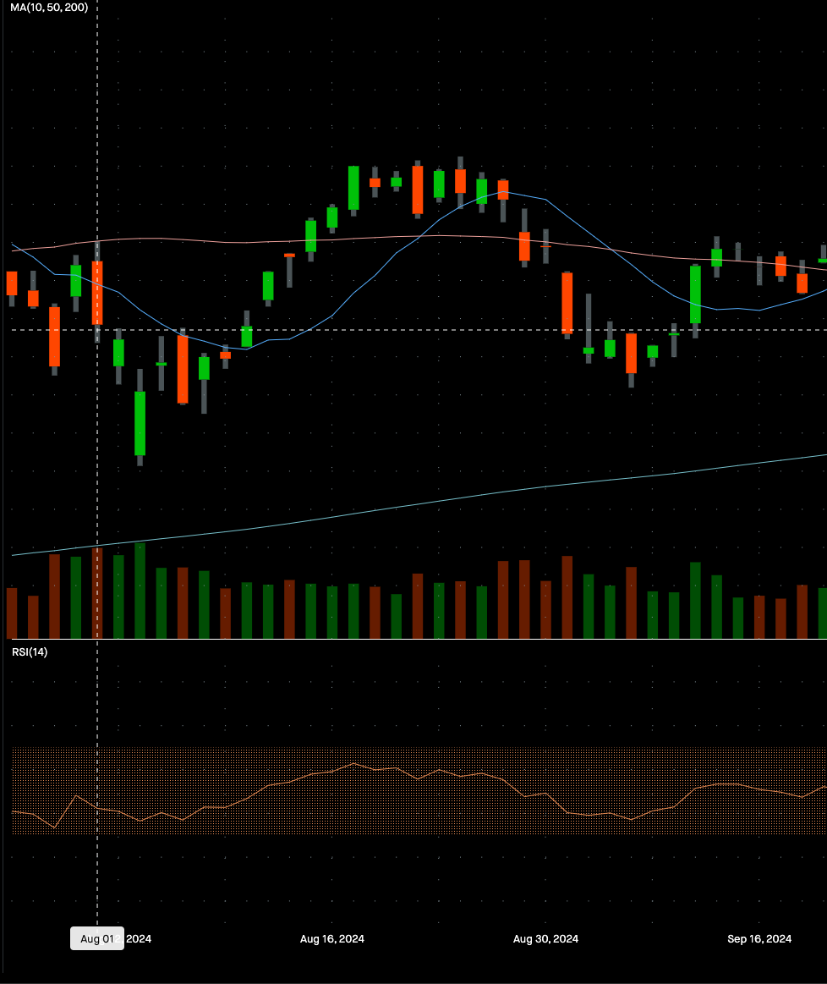
Candlestick Pattern Analysis
Bullish and Bearish Engulfing
Notes:
Mengge

Slide 23
Integration and Insights:
Model Analysis + Candlestick Pattern
Notes:
Yue

Slide 24
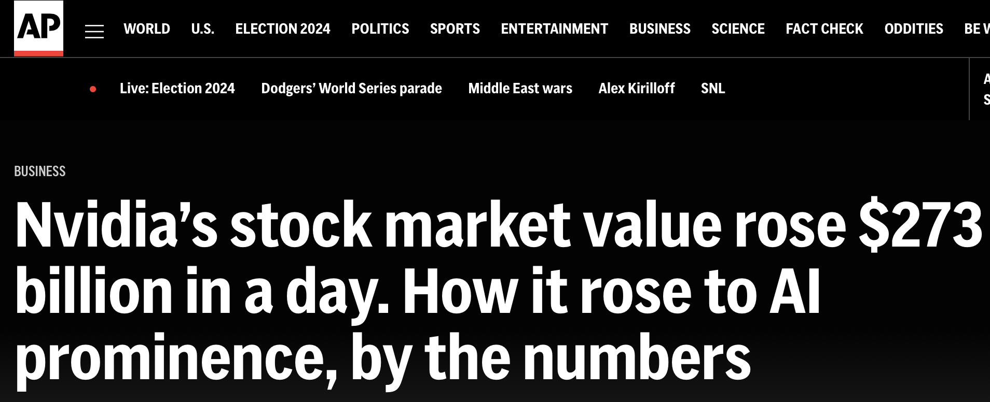
Breaking News - May 2023
Nvidia's data center revenue, climbed 14% year over year to a new record, while increasing 18% since CQ1 2023, and NVDA's leadership is becoming more undisputable.
The ever-increasing demand to build generative AI tools like ChatGPT fueled the upside likely to translate into revenue and margin upside in the CQ1 result outlook.
Notes:
Yue

Slide 25
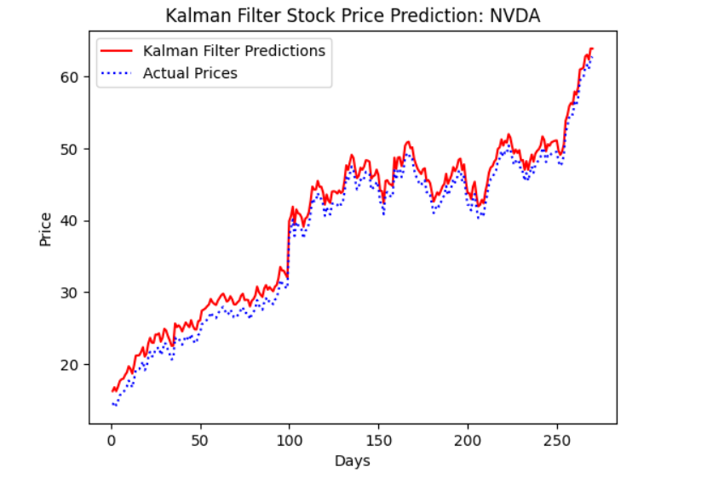
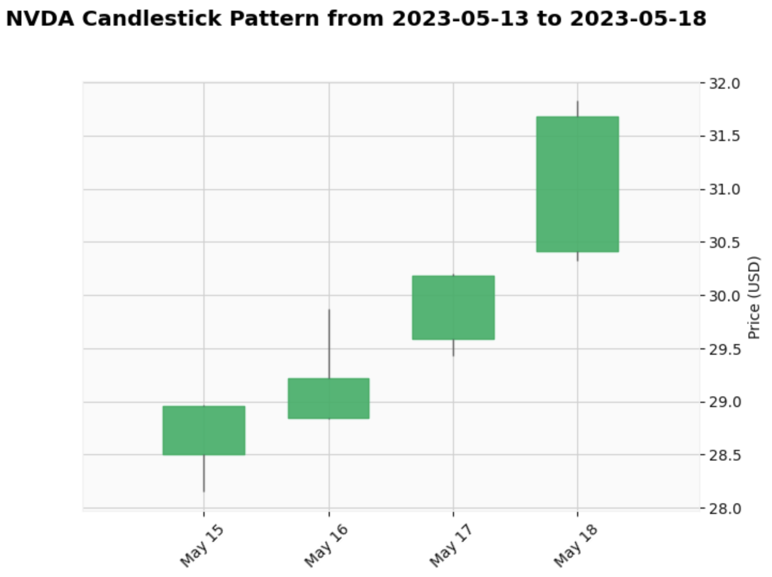
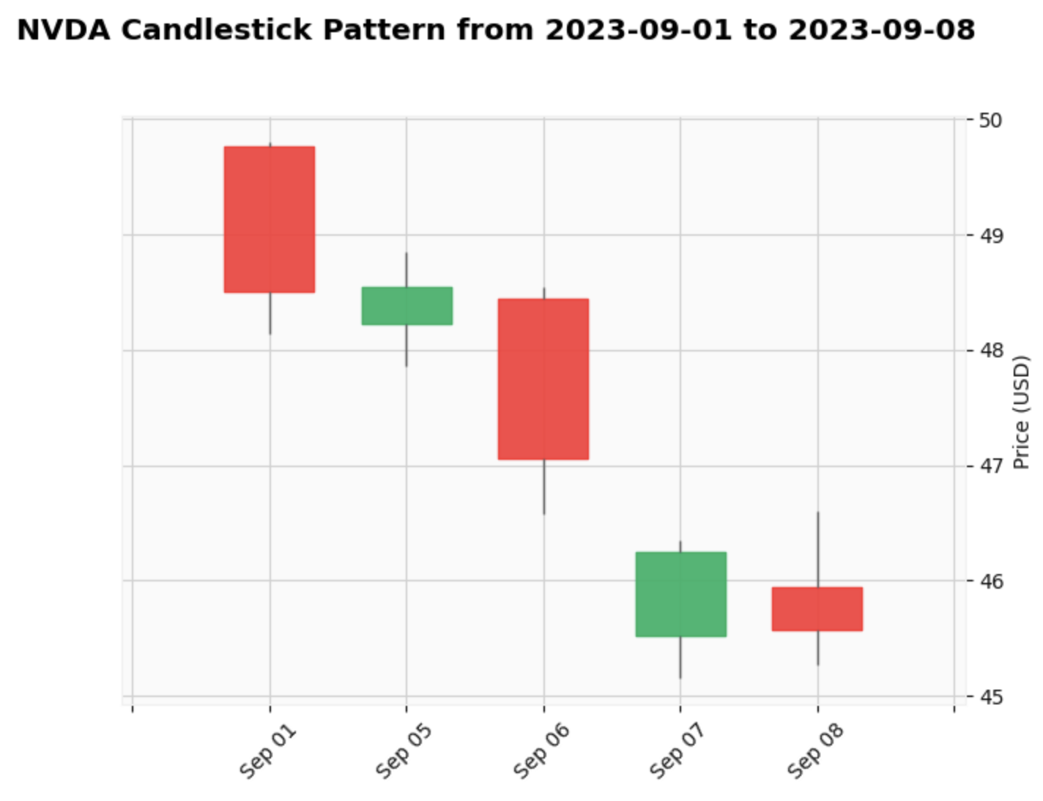
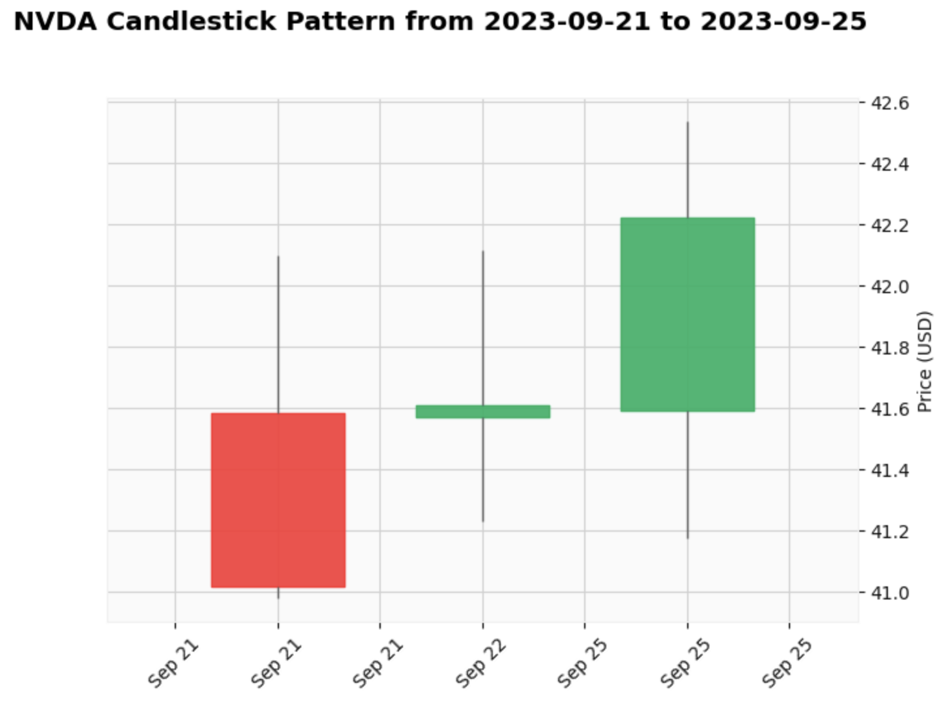
Stock Price Prediction Analysis
Three White Soldiers
Evening Star & Bearish Harami
Inverse Hammer
Notes:
Yue

Slide 26
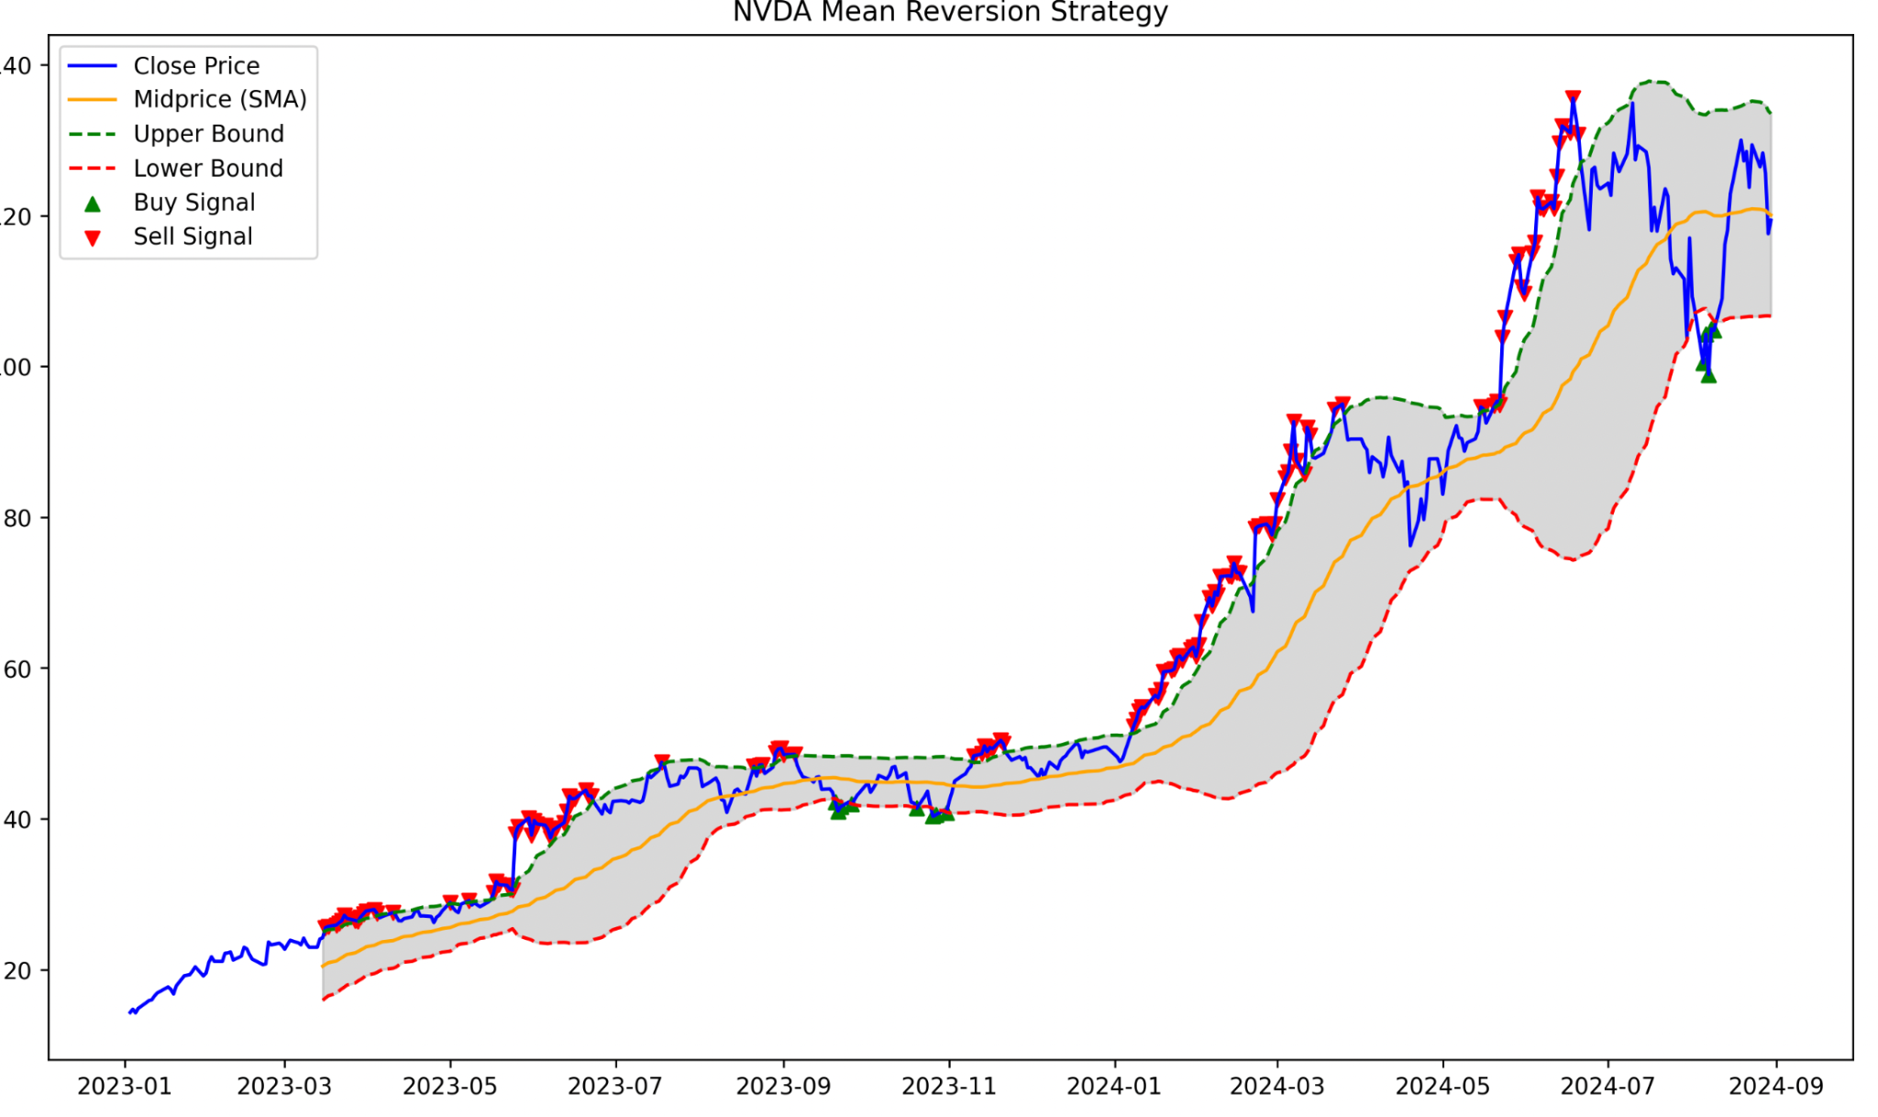
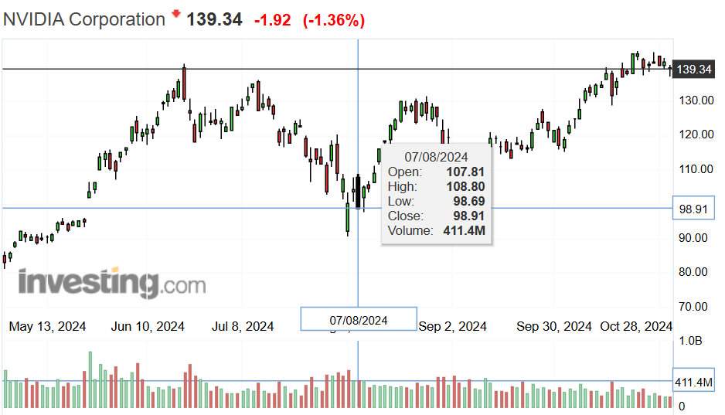
Mean Reversion Integration with Candlestick Pattern
Notes:
Yulun

